Slide 1

Gujarat University Department of Animation

Slide 2

Courier Management System
Presented By :-
Anjali Pawar
Shreya Patel

Slide 3
INTRODUCTION
Courier services are a more specialized delivery service that businesses and individuals turn to when they need a package or a document to reach its destination quickly.
While regular mail services can also deliver packages rapidly, they cannot guarantee same day delivery or overnight delivery as the case may be.
The term³courier service´ can refer to every form of delivery or transport service ranging from a small, local operation to an international network servicing millions daily using a fleet of trucks, planes, trains and ships.

Slide 4
TECHNOLOGY USED
Front end :- JAVA
Back end :- MYSQL
Developer Tool :- NOTEPAD

Slide 5

WELCOME TO OUR COURIER SYSTEM

Slide 6
MAIN MODULES
Login module:-
Admin
Registration Module:-
Admin
Courier Module:-
1. Receiver
2. Sender

Slide 7
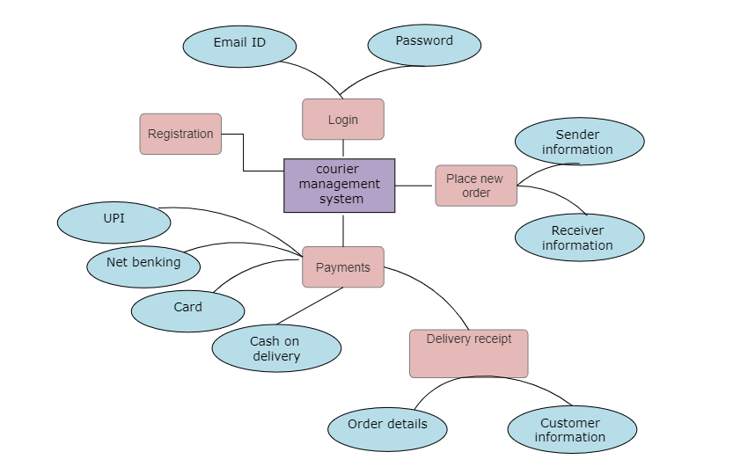
ER-Diagram

Slide 8
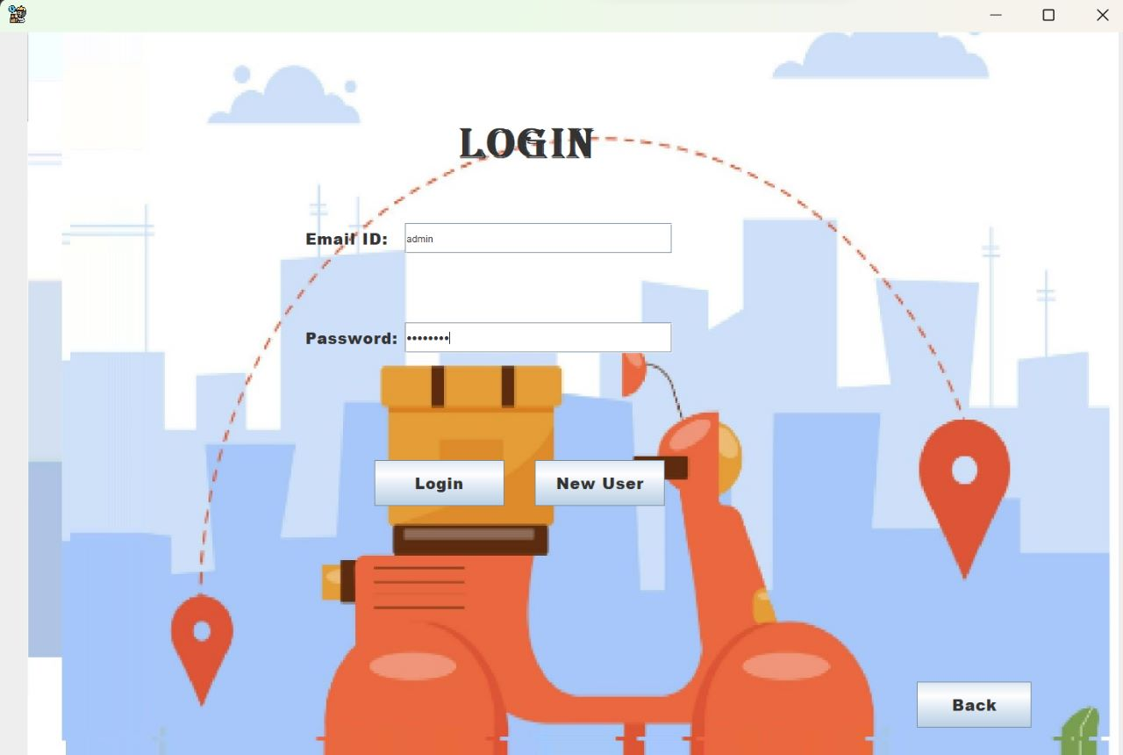

Have a look at our login module

Slide 9
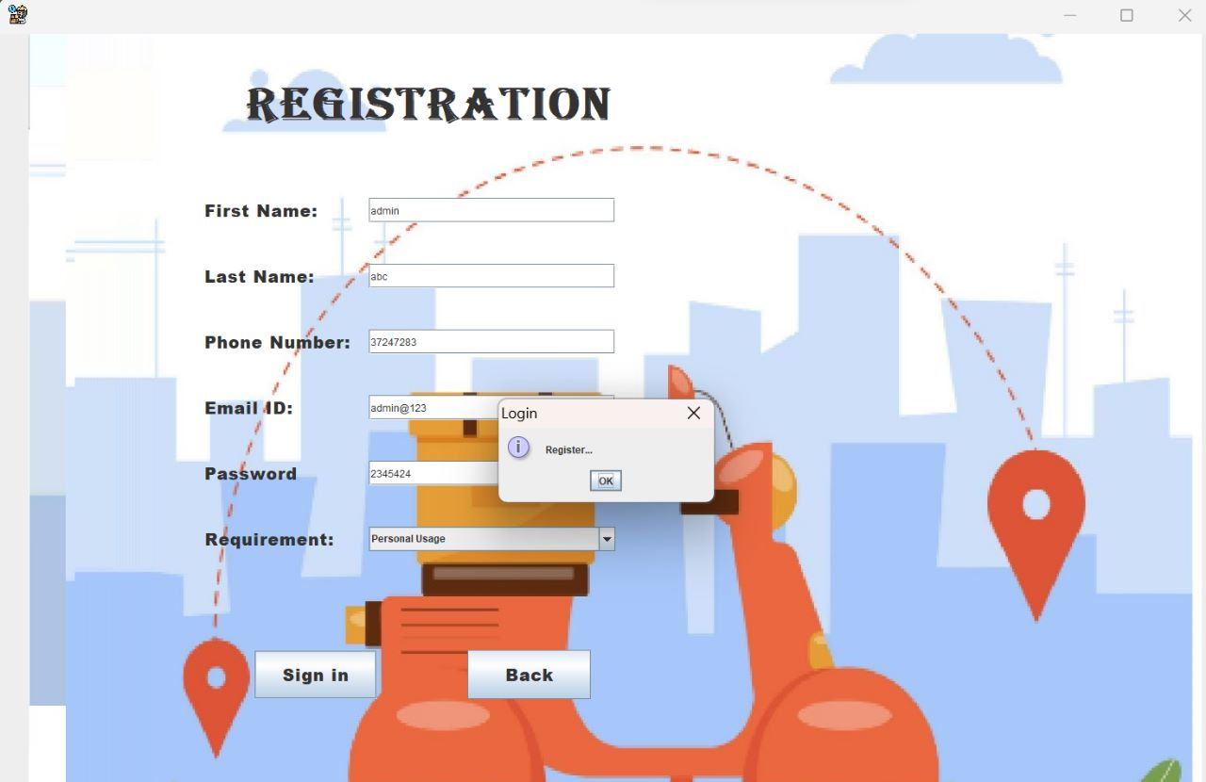
Registration Form
There are 3 prime uses of application
Business
Personal
House Shifting

Slide 10
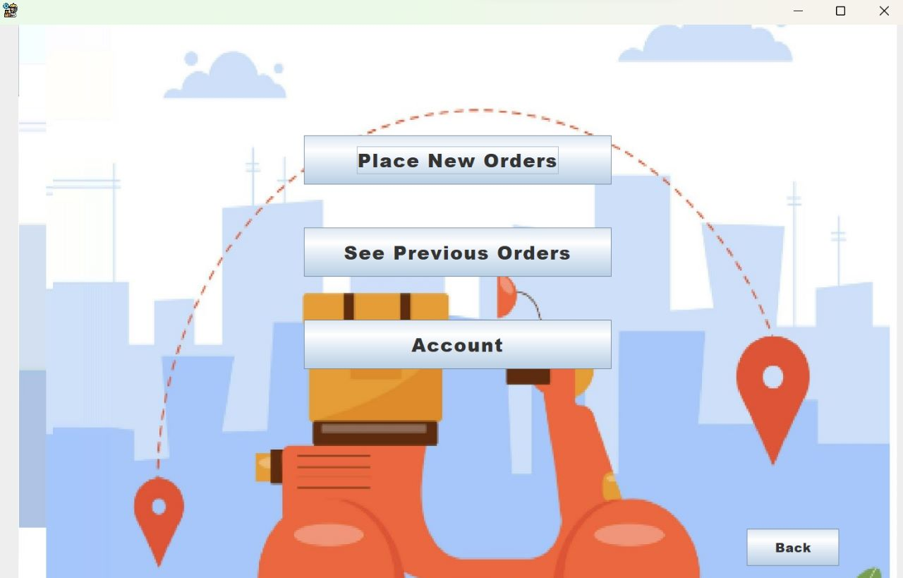
Orders details
Here user can see his previous order and he can place his new order

Slide 11
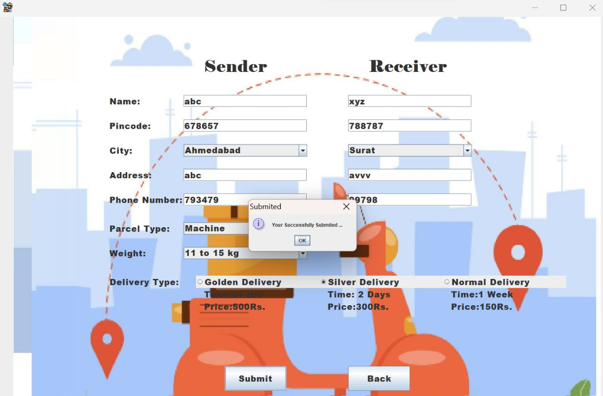

User’s Information

Slide 12
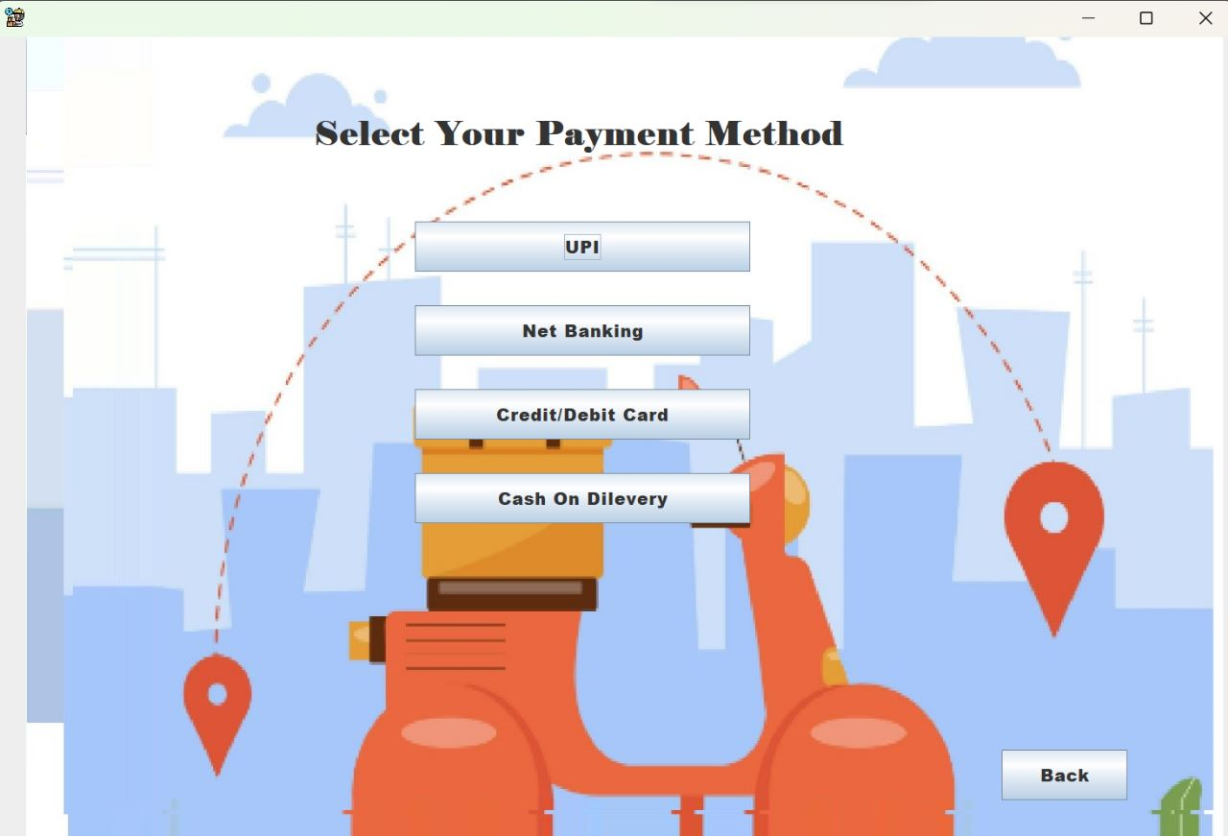
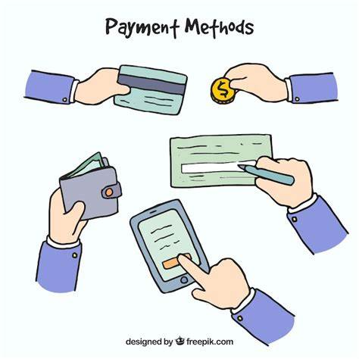
Payment Options

Slide 13
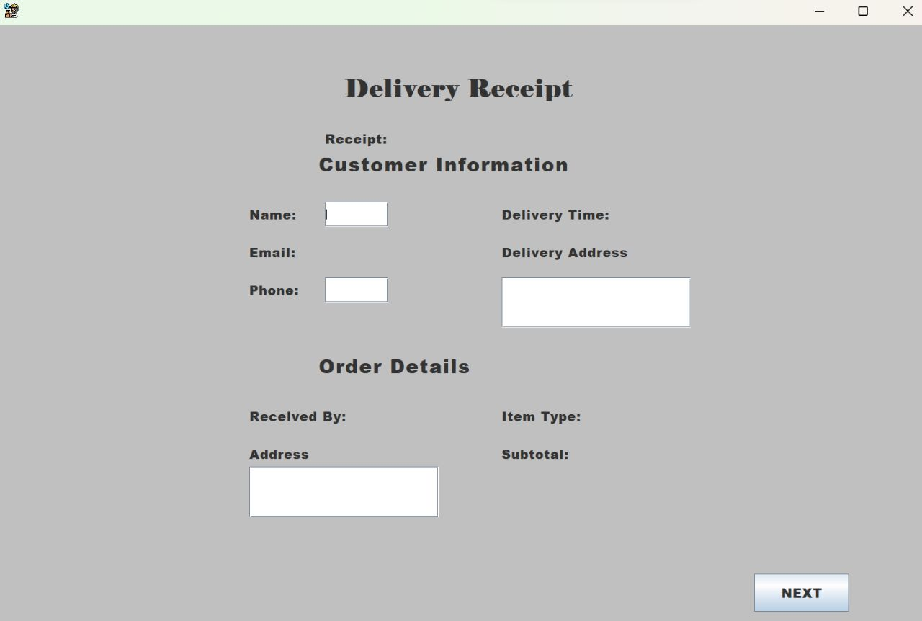

Delivery Receipt

Slide 14


